Slide 1

APEX INSTITUTE OF TECHNOLOGY
DEPARTMENT OF COMPUTER SCIENCE & ENGINEERING
Database Management System (21CST-232)
Faculty: Mr. Pramod Vishwakarma (E9758)
Lecture - 2
Databases Architecture
DISCOVER . LEARN . EMPOWER

Slide 2
DBMS: Course Objectives
COURSE OBJECTIVES
The Course aims to:
Understand database system concepts and design databases for different applications and to acquire the knowledge on DBMS and RDBMS.
Implement and understand different types of DDL, DML and DCL statements.
Understand transaction concepts related to databases and recovery/backup techniques required for the proper storage of data.

Slide 3
COURSE OUTCOMES
On completion of this course, the students shall be able to:-
CO1 | Understand the database concept, system architecture and role of database administrator
CO2 | Design database for an organization using relational model
CO3 | Apply relational algebra and relational calculus to query the database of organization
CO4 | Implement the package, procedures and triggers
CO5 | Understand the concept of transaction processing and concurrency control

Slide 4
Outline
Type of system Architectures
Data Base System Architecture (Three Level ANSI-SPARC Architecture)
Data Independence
Types of Data Independence

Slide 5
DBMS Architecture
The DBMS design depends upon its architecture. The basic client/server architecture is used to deal with a large number of PCs, web servers, database servers, and other components that are connected with networks.
The client/server architecture consists of many PCs and a workstation that are connected via the network.
DBMS architecture depends upon how users are connected to the database to get their requests done.

Slide 6
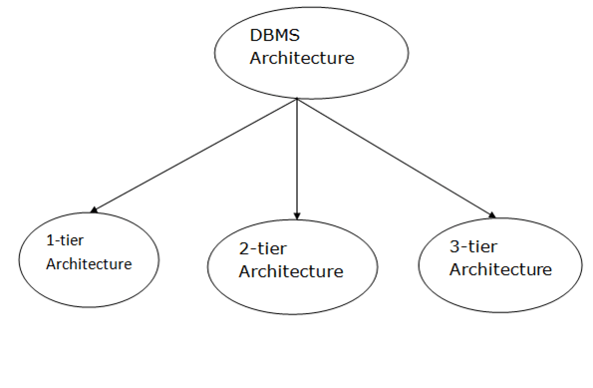
Type of Architectures
Image Source:Javatpoint.com

Slide 7
1-Tier Architecture
In this architecture, the database is directly available to the user. It means the user can directly sit on the DBMS and uses it.
Any changes done here will directly be done on the database itself. It doesn't provide a handy tool for end-users.
The 1-Tier architecture is used for the development of the local application, where programmers can directly communicate with the database for the quick response.

Slide 8
2-Tier Architecture
2-Tier architecture is the same as the basic client-server. In the two-tier architecture, applications on the client end can directly communicate with the database at the server-side. For this interaction, API's like ODBC, JDBC are used.
The user interfaces and application programs are run on the client-side.
The server side is responsible to provide the functionalities like query processing and transaction management.
To communicate with the DBMS, the client-side application establishes a connection with the server-side.

Slide 9
3-Tier Architecture
The 3-Tier architecture contains another layer between the client and the server. In this architecture, the client can't directly communicate with the server.
The application on the client-end interacts with an application server which further communicates with the database system.
End-user has no idea about the existence of the database beyond the application server. The database also has no idea about any other user beyond the application.
The 3-Tier architecture is used in case of the large web applications.

Slide 10
Three schema Architecture
The three schema architecture is also called ANSI/SPARC architecture or three-level architecture.
This framework is used to describe the structure of a specific database system.
The three schema architecture is also used to separate the user applications and physical database.
The three schema architecture contains three-levels. It breaks the database down into three different categories.

Slide 11
3-schema/views of Data
Physical level: describes how a record (e.g., customer) is stored.
Logical level: describes data stored in database, and the relationships among the data.
View level: application programs hide details of data types. Views can also hide information (such as an employee’s salary) for security purposes.
The database can be viewed from different levels of abstraction to reveal different levels of details. From a bottom-up manner, we may find that there are three levels of abstraction or views in the database.
The term Abstraction is very important here. Generally it means the amount of detail you want to hide. Any entity can be seen from different perspectives and levels of complexity to make it a reveal its current amount of abstraction.

Slide 12
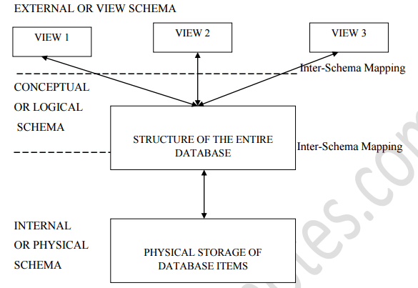
https://beginnersbook.com/2015/04/e-r-model-in-dbms/
The word schema means arrangement – how we want to arrange things that we have to store. The diagram above shows the three different schemas used in DBMS, seen from different levels of abstraction.
Instance – the actual content of the database at a particular point in time
★ Analogous to the value of a variable

Slide 13
Cont…
Three General levels :-
Internal Schema (Physical View) :-
The way the data is stored in the storage media. (Specified by the DBA)
Conceptual Schema (Logic View):-
Describes the structure and constraints for the whole database. (Specified and used by the programmers).
External Schema(Sub-Schema):-
The view of the database as seen by the end user.

Slide 14
Internal or physical schema
The lowest level, called the Internal or Physical schema, deals with the description of how raw data items (like 1, ABC, KOL, H2 etc.) are stored in the physical storage (Hard Disc, CD, Pen Drive etc.).
It also describes the data type of these data items, the size of the items in the storage media, the location (physical address) of the items in the storage device and so on. This schema is useful for database application developers and database administrator.

Slide 15
Conceptual or logical schema
The middle level is known as the Conceptual or Logical Schema, and deals with the structure of the entire database.
Please note that at this level we are not interested with the raw data items anymore, we are interested with the structure of the database.
This means we want to know the information about the attributes of each table, the common attributes in different tables that help them to be combined, what kind of data can be input into these attributes, and so on.
Conceptual or Logical schema is very useful for database administrators whose responsibility is to maintain the entire database.

Slide 16
External or View Schema
The highest level of abstraction is the External or View Schema.
This is targeted for the end users.
Now, an end user does not need to know everything about the structure of the entire database, rather than the amount of details he/she needs to work with.

Slide 17
Data Independence
It is the property of the database which tries to ensure that if we make any change in any level of schema of the database, the schema immediately above it would require minimal or no need of change.
Ability to modify a schema definition in one level without affecting a schema definition in the next higher level.
The interfaces between the various levels and components should be well defined so that changes in some parts do not seriously influence others.
What does this mean? We know that in a building, each floor stands on the floor below it. If we change the design of any one floor, e.g. extending the width of a room by demolishing the western wall of that room, it is likely that the design in the above floors will have to be changed also. As a result, one change needed in one particular floor would mean continuing to change the design of each floor until we reach the top floor, with an increase in the time, cost and labour. Would not life be easy if the change could be contained in one floor only? Data independence is the answer for this. It removes the need for additional amount of work needed in adopting the single change into all the levels above.

Slide 18
Types of Data Independence
Data independence can be classified into the following two types:
Physical Data Independence
Logical Data Independence
Physical Data Independence: This means that for any change made in the
physical schema, the need to change the logical schema is minimal. This is
practically easier to achieve.
Logical Data Independence: This means that for any change made in the
logical schema, the need to change the external schema is minimal. As we
shall see, this is a little difficult to achieve.

Slide 19
Summary
The DBMS design depends upon its architecture. The basic client/server architecture is used to deal with a large number of PCs, web servers, database servers, and other components that are connected with networks
Level of Data Independence gives the ability to modify a schema definition in one level without affecting a schema definition in the next higher level.

Slide 20
FAQs
What is Data Independence?
What are three level of independence?
What is 3- level architecture?
What is internal level independence?
What is conceptual level independence?
What is external level independence?

Slide 21
References
RamezElmasri and Shamkant B. Navathe, “Fundamentals of Database System”, The Benjamin / Cummings Publishing Co.
Korth and Silberschatz Abraham, “Database System Concepts”, McGraw Hall.
C.J.Date, “An Introduction to Database Systems”, Addison Wesley.
Thomas M. Connolly, Carolyn & E. Begg, “Database Systems: A Practical Approach to Design, Implementation and Management”, 5/E, University of Paisley, Addison-Wesley.

Slide 22
THANK YOU
For queries
Email: pramod.e9758@cuimail.in

